Slide 1
JUMBO PRIME
IMFORMATIONAL GUIDE

Slide 2
ACCOUNT EXECUTIVE GUIDE

Slide 3
Overview of program
Jumbo Prime is a program which differs from all others offered by Acra Lending. A lock desk has been created that will handle interest rate lock requests and dictate the pricing to the disclosure and closing departments. Rate locks and rate lock extensions are a valid Change In Circumstance when requested by the borrower (or the broker on the borrower’s behalf) and must be disclosed within 3 days to maintain compliance with the TRID requirements.
Checklist
Acra-Jumbo Prime-Submission-Checklist is required with all Jumbo Prime loan submissions.

Slide 4
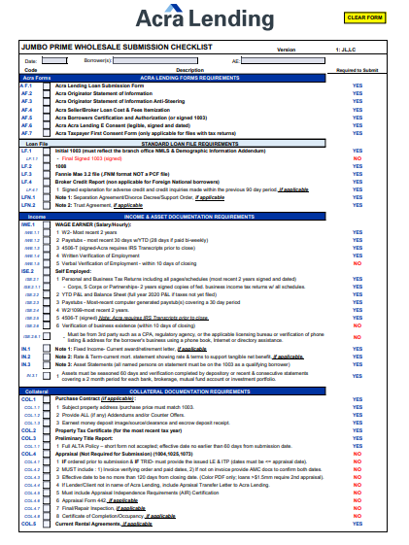

Slide 5
Overview of lock guidelines
Loans can be locked by the broker, on behalf of the borrower, for 30, 45, or 60 days. The interest rates available and the corresponding pricing will be made available via the Jumbo Prime Rate sheets and can be found on our website and the Cintranet. Rate locks can be extended for 15 days up to two separate times as needed. Loans may be locked as soon as a conditional approval has been issued.
Brokers will submit rate lock requests and extension requests to Lockdesk@acralending.com. The request must be completed using the “Rate Lock Request” form available in the broker portal. Rate lock request submissions received after 2:30pm PST are not able to be processed same day.
When the rate is locked a confirmation email will be sent out by Acra Lending’s lock desk to the broker, AE, and TM.
A rate lock must have at least 8 days remaining to be eligible to move to closing. If there are less than 8 days remaining a rate lock extension request must be submitted and processed.

Slide 6
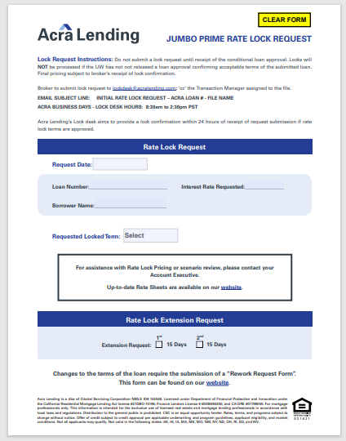

Slide 7
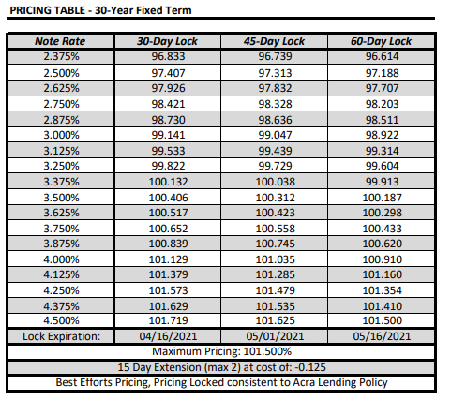
Pricing will display in the following format:
Pricing greater than 100.000 will display on the Loan Estimate and Closing Disclosure as a credit. Pricing less than 100.000 will display on the Loan Estimate and Closing Disclosure as discount points.
Changes to the terms of the loan will not be permitted at the time of rate lock. Any changes must follow the existing re-work process.

Slide 8
LOAN SET-UP GUIDE

Slide 9
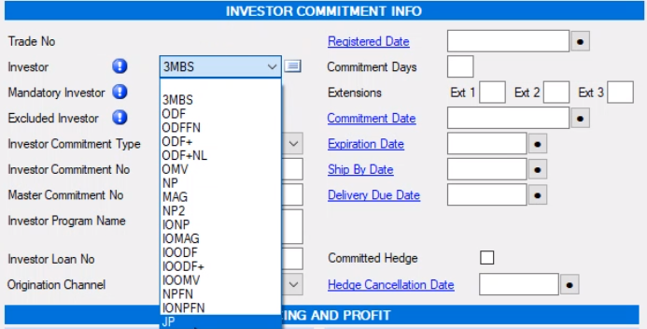
Loan Setup Guide
Select Program:
The loan program in the Loan Origination System must reflect Jumbo Prime (JP) for this type of loan.

Slide 10
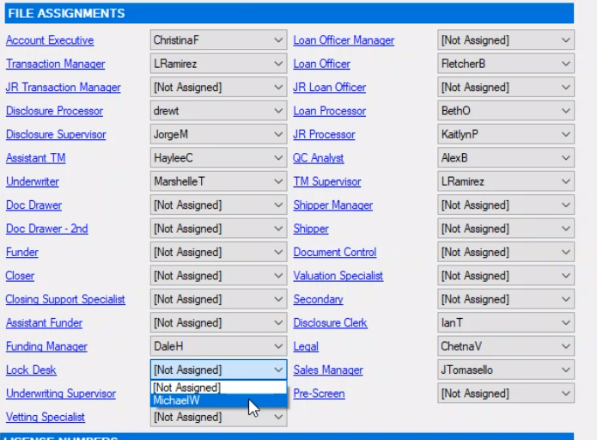
Add lock desk user
When selecting users on the Home screen a Lock Desk user must be selected for these loans.

Slide 11
TRANSACTION MANAGER GUIDE

Slide 12
Transaction Manager Guide
Overview of program
Jumbo Prime is a program which differs from all others offered by Acra Lending. A lock desk has been created that will handle interest rate lock requests and dictate the pricing to the disclosure and closing departments. Rate locks and rate lock extensions are a valid Change In Circumstance when requested by the borrower (or the broker on the borrower’s behalf) and must be disclosed within 3 days to maintain compliance with the TRID requirements.

Slide 13
Overview of lock guidelines
Loans can be locked by the broker, on behalf of the borrower, for 30, 45, or 60 days. The interest rates available and the corresponding pricing will be made available via the Jumbo Prime Rate sheets and can be found on our website and the Cintranet. Rate locks can be extended for 15 days up to two separate times as needed. Loans may be locked as soon as a conditional approval has been issued.
Brokers will submit rate lock requests and extension requests to Lockdesk@acralending.com. The request must be completed using the “Rate Lock Request” form available in the broker portal. Rate lock request submissions received after 2:30pm PST are not able to be processed same day.

Slide 14
When the rate is locked a confirmation email will be sent out by Acra Lending’s lock desk to the broker, AE, and TM.
A rate lock must have at least 8 days remaining to be eligible to move to closing. If there are less than 8 days remaining a rate lock extension request must be submitted and processed.

Slide 15
Pricing will display in the following format:
Pricing greater than 100.000 will display on the Loan Estimate and Closing Disclosure as a credit. Pricing less than 100.000 will display on the Loan Estimate and Closing Disclosure as discount points.
Changes to the terms of the loan will not be permitted at the time of rate lock. Any changes must follow the existing re-work process.

Slide 16
New Condition
15010 – TM to confirm rate lock LE has been received – Will autogenerate on submission of Jumbo Prime loans.
New tasks
Jumbo Prime Rate Lock Disclosure - LE
Mirrors Disclosure Draw Task
Jumbo Prime Rate Lock Disclosure CIC on CD
Mirrors Disclosure – Change Circumstance Request to Funding
Manual task created by QC in the event the CIC for rate lock can be processed on the CD (assuming funding can accommodate the timing of the CD release)
Jumbo Prime Rate Lock Extension LE
Mirrors Disclosure Draw Task
Jumbo Prime Rate Lock Extension CD
Assigned to: Doc Drawer
Due: 3 business days after creation
Visible to: AE, TM, ATM, Lock, Proc, LO, DOC, DOC2, FMNG, FUND, CLSR, CSS, AF, TMS
Priority: High

Slide 17
5. Jumbo Prime Re-Lock/Extension Required – Wholesale
Assigned To: TM
Due: 1 business day after creation
Visible to: AE, TM, JTM, ATM, DOC, DOC2, FUND, CLSR, CSS, AF, FMNG, Lock, QCA, TMS
Priority: High
This is for the closing department to request a relock or rate extension when they determine that the loan will not be able to fund before the current expiration.
6. Jumbo Prime Lock Update Request
Assigned to: Lock Desk
Due: 1 business day after creation
Visible to: AE, TM, Lock, TMS, UW, UWS, QCA, LO, Proc
Priority: High
This is for the Underwriter to request a pricing update from the lock desk when a re-work request is processed. The Lock desk will update the pricing on the Lock In Screen and task back to the Underwriter when complete.

Slide 18
7. Jumbo Prime Lock Update Complete
Assigned to: Underwriter
Due: 0 business day after creation
Visible to: AE, TM, Lock, TMS, UW, UWS, QCA, LO, Proc
Priority: High
This is for the Lock Desk to inform the underwriter that the rate lock has been updated and they are clear to proceed with the re-work/re-disclosure.
8. Jumbo Prime Investor Lock Reconciliation
Assigned to: Lock Desk
Due: 5 business days after creation
Visible to: Lock, QCA
Priority: Medium
This is for the lock desk to confirm that the final terms of the loan are updated in the investor rate lock portal. This is automatically generated on Jumbo Prime loans when moved to Closed status.

Slide 19
UNDERWRITING GUIDE

Slide 20
Overview of program
Jumbo Prime is a program which differs from all others offered by Acra Lending. A lock desk has been created that will handle interest rate lock requests and dictate the pricing to the disclosure and closing departments. Rate locks and rate lock extensions are a valid Change In Circumstance when requested by the borrower (or the broker on the borrower’s behalf) and must be disclosed within 3 days to maintain compliance with the TRID requirements.

Slide 21
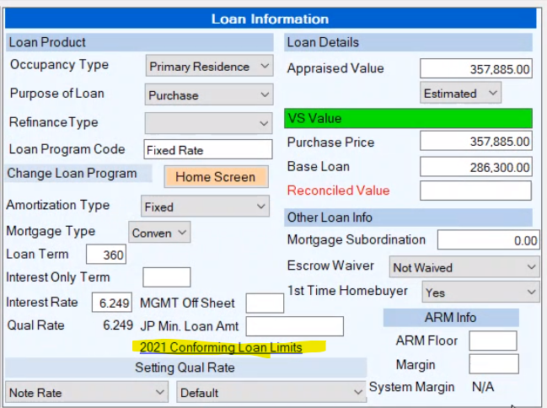
Initial Loan Underwriting
Upon submission the Underwriter will be responsible for entering the conforming loan limit into the Bytepro file using the following steps:
Navigate to the ULA Screen
2. In the Loan Information section click the link to access the current conforming loan limit guidelines.

Slide 22
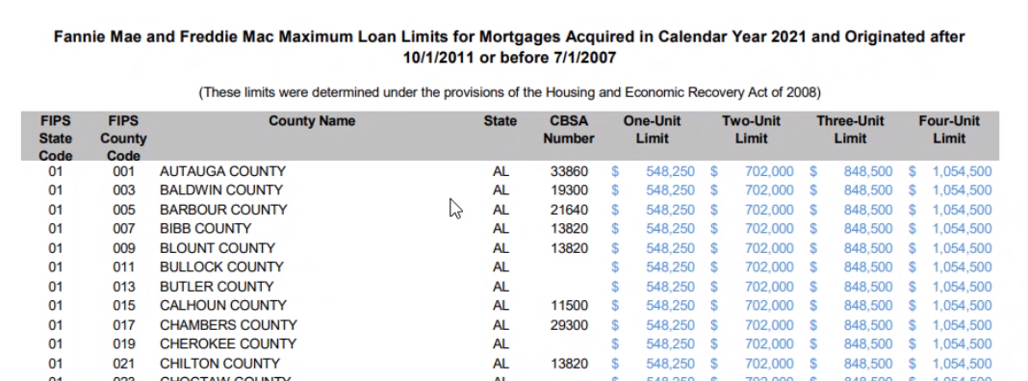
3. Using the number of units and the county of the subject property identify the applicable conforming loan limit.

Slide 23
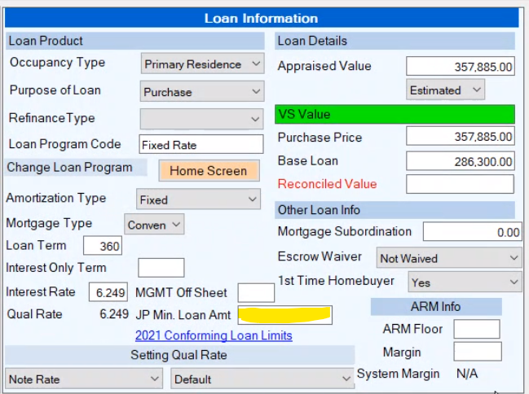
4. On the ULA screen enter the applicable conforming loan limit in the “JP Min. Loan Amount” field.

Slide 24
Rework Request Process Updates
Upon receipt of a re-work request on a Jumbo Prime loan the Underwriter will update the loan file and assess eligibility as normal. The loan pricing will need to be updated if any of the following fields are changed:
Loan Amount
Interest Rate
Appraised Value
Credit Score
Occupancy
Purpose
Property Type
DTI
Impounds
Reserve Months Required
Self-Employed Status

Slide 25
For pricing updates the Underwriter will create a task for the Lock desk to update the loan file. The lock desk must complete the pricing update before re-disclosures may be issued. The Underwriter will create the “Jumbo Prime Lock Update Request” task to trigger the Lock Desk review. When the lock desk has completed the pricing update they will create the “Jumbo Prime Lock Update Complete” task which is assigned to the Underwriter. The Underwriter may clear this task and initiate a re-disclosure task using the normal procedure.

Slide 26
New Tasks
Jumbo Prime Lock Update Request
Assigned to: Lock Desk
Due: 1 business day after creation
Visible to: AE, TM, Lock, TMS, UW, UWS, QCA, LO, Proc
Priority: High
This is for the Underwriter to request a pricing update from the lock desk when a re-work request is processed. The Lock desk will update the pricing on the Lock In Screen and task back to the Underwriter when complete.
Jumbo Prime Lock Update Complete
Assigned to: Underwriter
Due: 0 business day after creation
Visible to: AE, TM, Lock, TMS, UW, UWS, QCA, LO, Proc
Priority: High
This is for the Lock Desk to inform the underwriter that the rate lock has been updated and they are clear to proceed with the re-work/re-disclosure.

Slide 27
DISCLOSURES GUIDE

Slide 28
How to disclose initial rate lock
Upon receipt of one of the tasks below the disclosure processor should review the Lock In Confirmation form in DocVelocity (labeled: Lock Confirmation). Every rate lock will have an associated price which will need to be entered as either discount points or a general lender credit.
If the price is above 100.00 a credit will be added for the rate lock.
If the price is below 100.00 discount points will be added for the rate lock.
The disclosure processor should also confirm that the correct lock expiration date is reflected on the LE before issuing to the borrower.

Slide 29
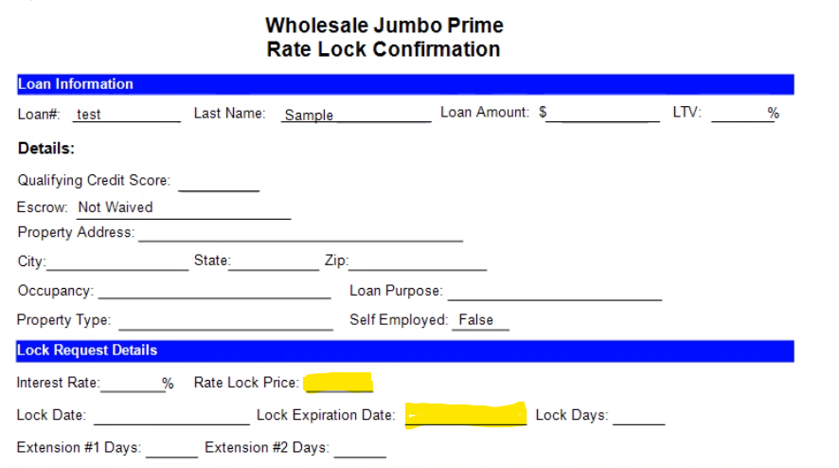

Slide 30
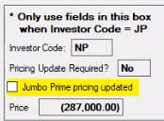
How to re-disclose updated pricing
1. When processing a “Re-Disclosure Draw Task” for a Jumbo Prime loan the disclosure processor ----must use the following steps.
2. Navigate to the Truth In Lending/Reg Z screen If the Pricing Update Required? Field reflects “yes” ---update the lender credits/discount points to match the new pricing displayed in the “Price” field
3. When pricing has been updated, check the “Jumbo Prime pricing updated” checkbox.
4. Proceed with the normal re-disclosure process.

Slide 31
New Tasks
Jumbo Prime Rate Lock Disclosure - LE
This task should be processed in the same manner as the Disclosure Draw Task but will require the inclusion of rate lock pricing and expiration.
Jumbo Prime Rate Lock Extension LE
This task should be processed in the same manner as the Disclosure Draw Task but will require the inclusion of extended rate lock pricing and expiration.

Slide 32
LOCK DESK GUIDE

Slide 33
Lock Desk Guide
Receiving a Rate Lock Request
Rate lock requests will be submitted to Lockdesk@acralending.com. A completed lock request form must be submitted for the rate lock to be processed.
External Portals
The interest rate should be locked within 24 hours of receipt of a rate lock request or extension request. The rate must be locked with the investor prior to disclosing rate lock terms to the borrower. Investor interest rate lock terms should be 15 days longer than the term requested by the borrower (extensions should be the same term).

Slide 34
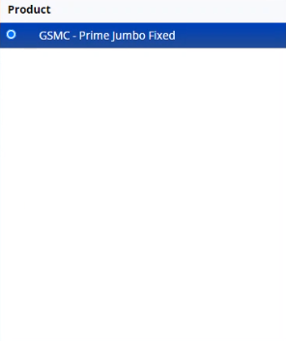
Goldman Sachs Portal:
1. Navigate to the GS portal at https://loan-lock.amcfirst.com/pub_homepage?redirect_url=cust_pipeline_loan%2F301753%2F200041186
2. Enter Login Credentials (administered by GS)
3. Factor Authentication via Google Authenticator (requires app download)
4. To Lock a new loan choose ”Rate Lock” at the top of the page.
5. Choose GSMC- Prime Jumbo Fixed as the product

Slide 35
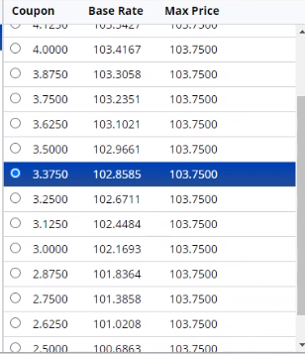
6. Choose Coupon rate option as specified on the Rate Lock Request Form

Slide 36
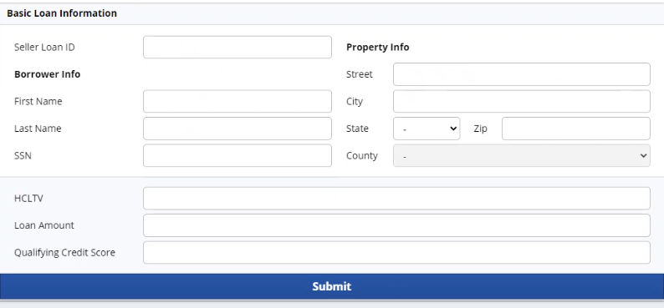
7. Enter the basic loan information as reflected in the LOS.
8. Click submit when done
9. Enter all adjustments as reflected in the LOS.

Slide 37
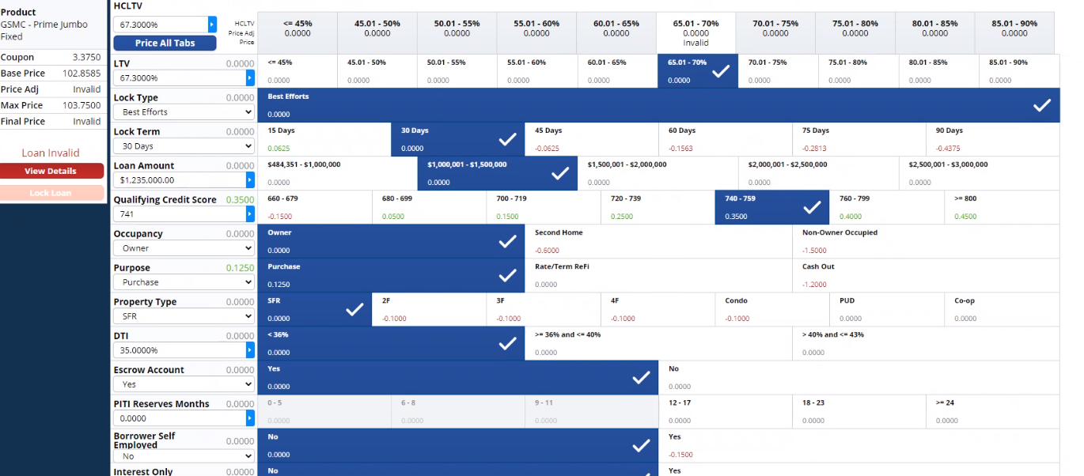
a. Calculate PITI reserves using rate sheet and REO table in LOS.
10. When complete click “Lock Loan” button on left side of screen.
11. 180 seconds provided to check work, click “Accept” button when ready
12. When disclaimer pops up click “I Agree” button.

Slide 38
Lock In Information Screen
Fields have been added to the lock in information screen that will be used to track information related to the rate lock. The Investor Commitment Info should be used to track the terms of the rate lock. The Price Calculator should be used to document the adjustments made to achieve the final borrower price as referenced on the rate sheet. The Basic Loan Information section is available for quick reference when completing the investor lock or updating the locked terms.

Slide 39
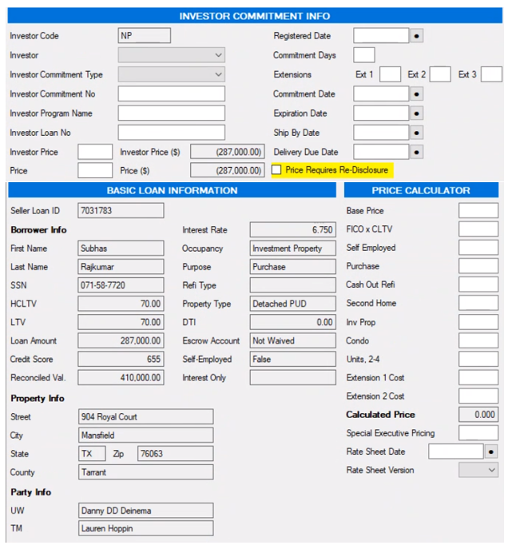
When all information has been filled on the Lock In Information screen complete the following steps:
Choose the appropriate task from the list below
Create a note in the conversation log with details of rate lock
Print Acra – Wholesale Jumbo Prime Rate Lock Confirmation (from the Lock In Screen)
Upload a copy to DocVelocity with the document tag “Lock Confirmation”
Add note to designate whether initial lock or lock extension.
Send notification email to Broker, AE, TM with Acra – Wholesale Jumbo Prime Rate Lock Confirmation attached.
Also attach the rate sheet used for the broker’s reference.
Upload a copy of Rate Lock Request for all loans to DV

Slide 40
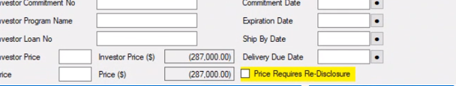
Changes to existing locks
The broker may update the terms of the loan by submitting a re-work request which will trigger the Underwriter to review the file. If changes are made to the loan which may affect the pricing the Underwriter will create a “Jumbo Prime Lock Update Request” task.
1. Upon receipt of a “Jumbo Prime Lock Update Request” task, The lock desk should review the new terms in Bytepro and update the investor portal.
2. If eligible the lock desk will then update the pricing on the Lock in Screen
3. If pricing on the loan was updated and requires redisclosure the lock desk must click the “Price Requires Re-disclosure checkbox” on the Lock In Screen.
4. Print an updated “Acra – Wholesale Jumbo Prime Rate Lock Confirmation” document in Bytepro and upload to DocVelocity with the Tag “Lock Confirmation”.
5. Clear the “Jumbo Prime Lock Update Request” task
6. Create a “Jumbo Prime Lock Update Complete” task.

Slide 41
Closed Loan Investor Lock Reconciliation
All closed Jumbo Prime Loans require the lock desk to confirm that the investor lock reflects the final terms of the loan. Upon status change to Closed a task will be auto generated to initiate the process. Use the following steps to complete:
Upon receipt of a “Jumbo Prime Investor Lock Reconciliation” task log into the investor portal and locate the rate lock for the specified loan.
Confirm that all terms match the information in Bytepro.
If any terms do not match update the investor lock to match the terms in Bytepro.
Once all terms match, Clear the “Jumbo Prime Investor Lock Reconciliation” task.

Slide 42
QM Testing
The Lock Desk will need to complete a QM test in Bytepro to confirm that the rate lock terms are eligible.
To administer the test in BytePro a few items must be known:
The total amount of discount points
Par / Undiscounted rate
Par / Undiscounted price
For the initial test access the loan in “Sandbox Mode” as inputs to the LE or CD page 2 will be required. Follow the process below once the loan has been opened in “Sandbox Mode”

Slide 43
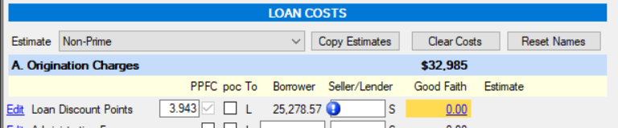

Testing a loan that has discount points for QM status requires the entry of discount points on the Loan Estimate Page 2 screen.
Enter all Discount Points Loan Estimate Page 2
Bona Fide Designations
1. Once the discount point amounts are entered, move to the Compliance screen for additional editing.
2. Locate the Points and Fees section, about halfway down the screen. Find the Discount Points subsection.
3. If the entire points percentage is bona fide, select the correct bona fide designation from the Discount Points Bona Fide drop-down.
a. Bona fide type selections that include the word 'Federal' or the 'Bona Fide for All Tests' phrase will designate the points as bona fide for QM testing.

Slide 44
How Do You Exclude your QM Bona Fide Points from Points and Fees?
The maximum number of points that can be excluded will depend on the difference between the following rates:
the APOR in effect when the interest rate is locked, and
the undiscounted interest rate, entered in the Par / Undiscounted Rate field.
NOTE: Both rates must be entered and accurate for the points exclusion calculation to be correct.
The “Undiscounted rate” can be defined as follows:
The undiscounted, fully adjusted par interest rate is the rate obtained from our rate sheet that includes all loan level pricing adjustments so that the price for the undiscounted rate is close to par. The undiscounted par rate must be available, not calculated. Since a rate that is exactly par is rarely available, the mechanism for selecting the rate should be consistent across the organization, and documented. For example, an organization might consistently select the available undiscounted rate that is less than, but closest to, a par price.

Slide 45
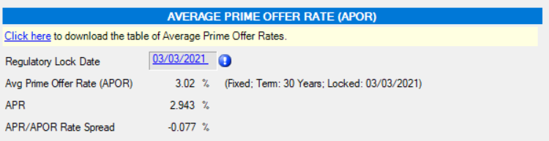

Excluding the QM bona fide points from Points and Fees:
Verify that the file has a valid APOR rate (see the APOR section towards the top of the Compliance screen). The APOR rate is dependent upon an entered lock date or Regulatory Lock Date (in the APOR section) and the downloaded APOR table over the date range containing the lock date.
NOTE that the APOR Rate is downloaded on a weekly basis. You will not need to down load the latest APOR
Enter the undiscounted par rate in the Par / Undiscounted Rate field.
It is also good practice to enter the Par / Undiscounted Price, but it will not affect the calculation. It's for documentation only.

Slide 46
Once all the information has been entered you can expect the following:
If the difference between the Par / Undiscounted Rate and the APOR is 1% or less, up to 2.00% discount points can be excluded from the Points and Fees total.
If the difference is greater than 1.00% but less than or equal to 2.00%, you can deduct up to 1.00% in discount points.
If the difference is greater than 2.00%, no discount points can be excluded.

Slide 47
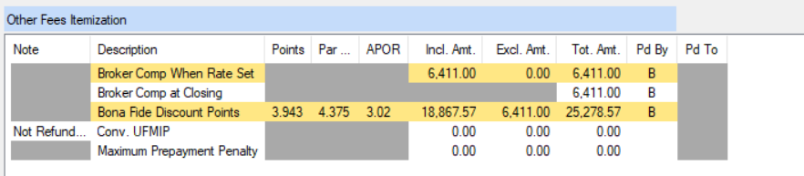
What's the Result?
You'll need to look in the Other Fees Itemization table just below the Points section:
The Bona Fide Discount Points itemization will contain the bona fide points total percentage (the Points column), the Par / Undiscounted Rate (the Par Rate column), and the APOR for the file. Compute the difference between the par rate percentage and the APOR, and compare it with the rules listed above.
The included and excluded amounts are listed next in the Points itemization (still in the table just above). In the example shown, the difference between APOR and the Par / Undiscounted Points rate (the Par Rate column) is 4.375% - so 1% of bona fide discount points can be excluded. The remaining 1% of points is included in the Points and Fees total.

Slide 48
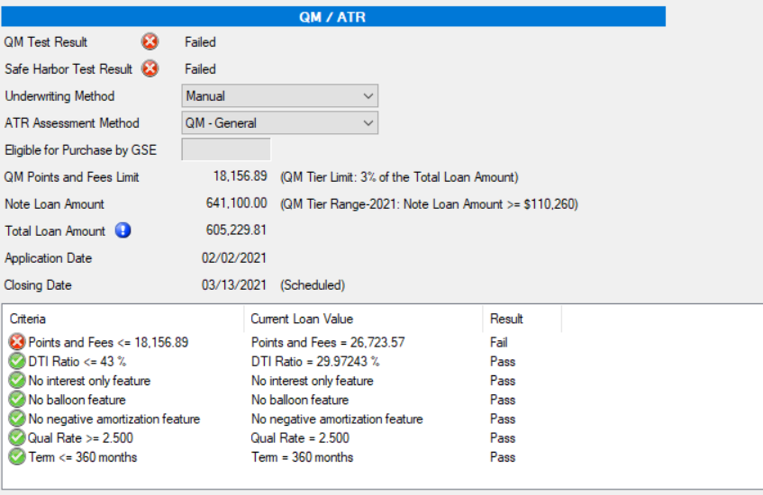
BytePro will automatically deduct the maximum number of QM bona fide discount points from the Points and Fees total, shown at the top of the Points and Fees section on the Compliance screen.
The compliance screen will provide additional information once all of this information is entered.
If the QM Test fails, the loan or rate lock will need to be re-worked.

Slide 49
NEW TASKS GUIDE

Slide 50
Jumbo Prime Rate Lock Disclosure - LE
Mirrors Disclosure Draw Task
Jumbo Prime Rate Lock Disclosure CIC on CD
Mirrors Disclosure – Change Circumstance Request to Funding
Manual task created by QC in the event the CIC for rate lock can be processed on the CD (assuming funding can accommodate the timing of the CD release)
Jumbo Prime Rate Lock Extension LE
Mirrors Disclosure Draw Task
Jumbo Prime Rate Lock Extension CD
Assigned to: Doc Drawer
Due: 3 business days after creation
Visible to: AE, TM, ATM, Lock, Proc, LO, DOC, DOC2, FMNG, FUND, CLSR, CSS, AF, TMS
Priority: High

Slide 51
5. Jumbo Prime Re-Lock/Extension Required – Wholesale
Assigned To: TM
Due: 1 business day after creation
Visible to: AE, TM, JTM, ATM, DOC, DOC2, FUND, CLSR, CSS, AF, FMNG, Lock, QCA, TMS
Priority: High
This is for the closing department to request a relock or rate extension when they determine that the loan will not be able to fund before the current expiration.

Slide 52
6. Jumbo Prime Lock Update Request
Assigned to: Lock Desk
Due: 1 business day after creation
Visible to: AE, TM, Lock, TMS, UW, UWS, QCA, LO, Proc
Priority: High
This is for the Underwriter to request a pricing update from the lock desk when a re-work request is processed. The Lock desk will update the pricing on the Lock In Screen and task back to the Underwriter when complete.

Slide 53
7. Jumbo Prime Lock Update Complete
Assigned to: Underwriter
Due: 0 business day after creation
Visible to: AE, TM, Lock, TMS, UW, UWS, QCA, LO, Proc
Priority: High
This is for the Lock Desk to inform the underwriter that the rate lock has been updated and they are clear to proceed with the re-work/re-disclosure.

Slide 54
8. Jumbo Prime Investor Lock Reconciliation
Assigned to: Lock Desk
Due: 5 business days after creation
Visible to: Lock, QCA
Priority: Medium
This is for the lock desk to confirm that the final terms of the loan are updated in the investor rate lock portal. This is automatically generated on Jumbo Prime loans when moved to Closed status.

Slide 55
CLOSING / FUNDING GUIDE

Slide 56
Overview
Jumbo Prime is a program which differs from all others offered by Acra Lending. A lock desk has been created that will handle interest rate lock requests and dictate the pricing to the disclosure and closing departments. Rate locks and rate lock extensions are a valid Change In Circumstance when requested by the borrower (or the broker on the borrower’s behalf) and must be disclosed within 3 days to maintain compliance with the TRID requirements.

Slide 57
New Tasks
Jumbo Prime Rate Lock Disclosure CIC on CD
Mirrors Disclosure – Change Circumstance Request to Funding
Manual task created by QC in the event the CIC for rate lock can be processed on the CD (assuming funding can accommodate the timing of the CD release)
Jumbo Prime Rate Lock Extension CD
Assigned to: Doc Drawer
Due: 3 business days after creation
Visible to: AE, TM, ATM, Lock, Proc, LO, DOC, DOC2, FMNG, FUND, CLSR, CSS, AF
Priority: High

Slide 58
How to disclose fees
When an interest rate is locked or extended a document will be uploaded by lock desk to DocVelocity titled “Lock Confirmation”. This document will include the locked interest rate. Every interest rate will have either discount points or lender credits which will be noted on the Lock Confirmation.
If a lock has discount points the CD Page 2 field “discount points” must be updated to match the figure on the Lock Confirmation.
If a lock has lender credits the CD section J field for Total Lender credits must be updated to match the figure on the Lock Confirmation.

Slide 59
Rate lock/extension guidelines
Minimum of 8 days remaining on rate lock to be allowed to move to closing.
Closing dept will monitor rate lock expiration and notify AE, TM, and Broker if an extension will be required.

